Slide 1
CAPSTONE PROJECT
Recreate Classic 2D Game
Ryan Phillips
1702465

Slide 2
What have I achieved so far?
Created base applet including basic thread handling
Programmed and tested complete sprite-sheet loader for in-game actors
Designed game state system to incorporate all game functionality
Developed functioning menu system for client navigation
Implemented Vector2f class to manage actors

Slide 3
What were my targets for the MVP deliverable?
Complete menu system fluidly redirecting players
01
Functioning sprite loader to render objects
02
Working collision detection between object interactions
03
Auto-saving and loading hiscores
04
Appropriate input handlers for user interaction
05

Slide 4

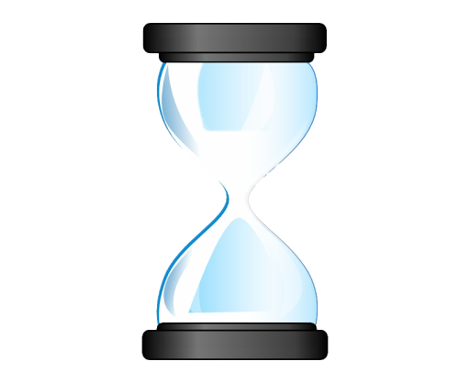
Which targets have I achieved?
Complete menu system fluidly redirecting players
01
Functioning sprite loader to render objects
02
Working collision detection between object interactions
03
Auto-saving and loading hiscores
04
Appropriate input handlers for user interaction
05

Slide 5
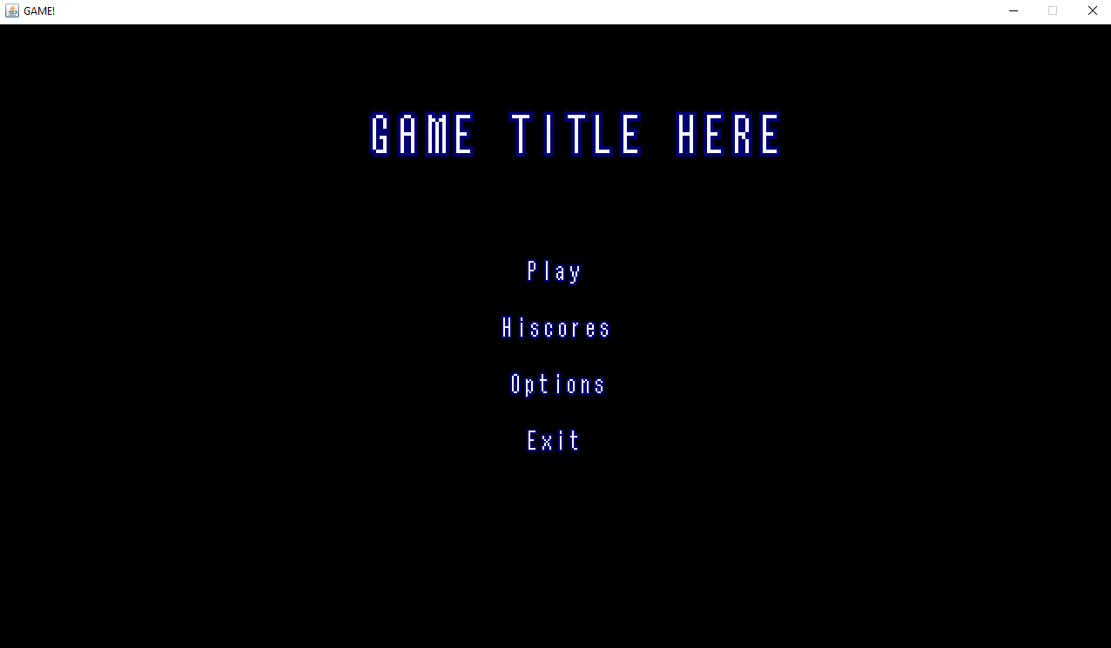
Deliverable 01: Complete Menu System

Slide 6
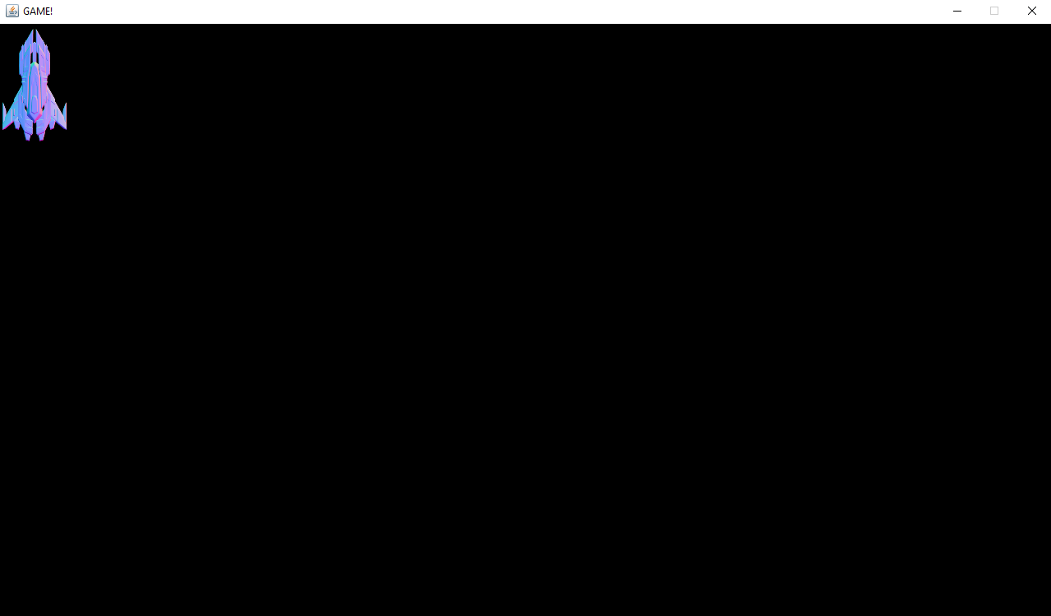
Deliverable 02: Functioning Sprite Loader

Slide 7

How am I finding the project?
Enjoying managing my own project.
Progress slow but steady – due to pick up pace.
Learning a lot regarding programming and project management.
Gaining understanding on project functionality – how deadlines can be delayed.
Notes:
1) Doing work when suitable, adding my desired features and functionality
2) Workload – less module after christmas
3) Learning new skills
4) Missing two targets shows how projects can change etc

Slide 8
How will I complete remaining MVP targets?
Appropriately organise time periods to complete functions
Retrace implemented functionality and program basic key features
Catching up on reallocated time during winter break

Slide 9
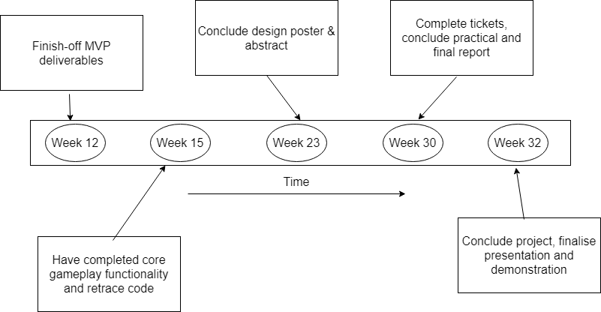
What is my time-scale for the remainder of the project?
Notes:
1) Doing work when suitable, adding my desired features and functionality
2) Workload – less module after christmas
3) Learning new skills
4) Missing two targets shows how projects can change etc

